Slide 1
King County Housing Analysis
How to maximize value by Mercy Ngila

Slide 2
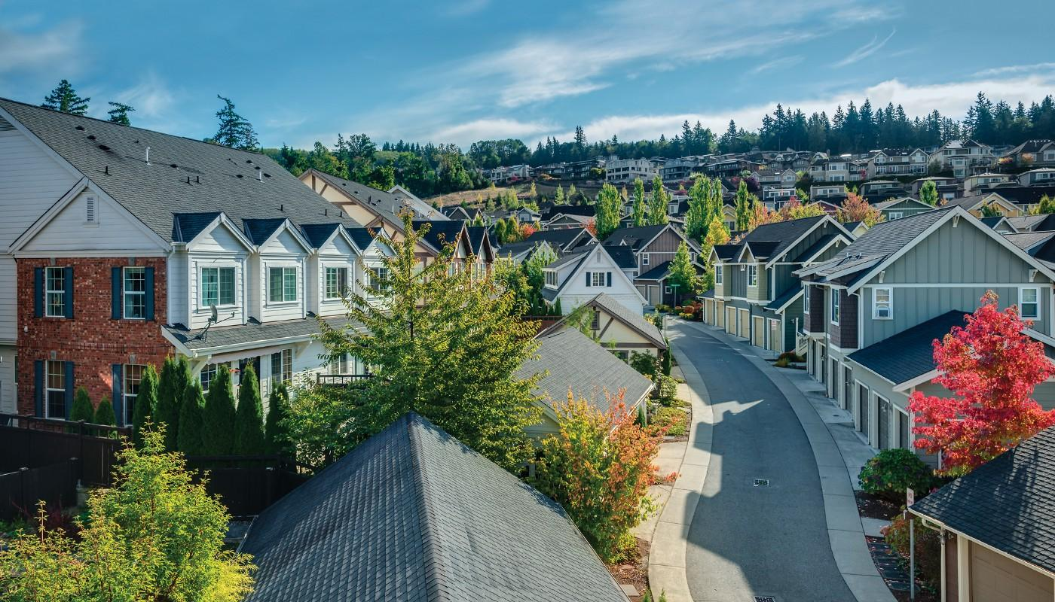

Slide 3
The problem
Company
Problem statement
Problem statement
Sunset Real Estate Company
The Company, is currently exploring the idea of purchasing properties to remodel either for the purpose selling or renting to prospective clients in King County.

Slide 4
Objectives
Objective 1
Objective 2
Objective 3
To build a model that predicts the price of houses with an acceptably high accuracy.
To identify variables with the most weight when it comes to predicting the highest market price.
To advice on the best investment strategy

Slide 5
Best model for maximized market price
EDA
Multiple Regression
Best Investment Strategy
Business Problem
Data
Methods
Conclusion
Recommendations
KC Housing Data, previous King County Housing data
Summary

Slide 6
Key Factors
Location
Spacious Interior
Condition

Slide 7
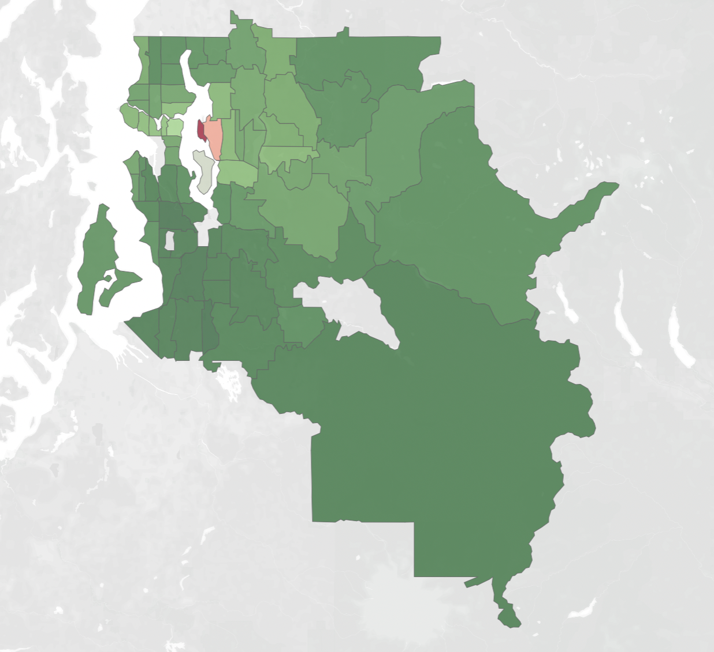
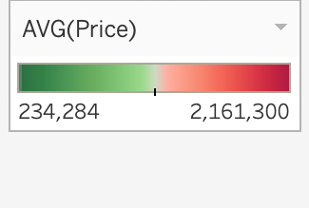
Location
A volatile factor in home value
Some zip codes will fetch more $$$ than others
Priciest - Medina, WA (Zip Code 98039)

Slide 8
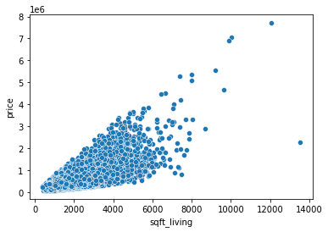
Spacious Interiors
More square footage in the house
More space = More $$$

Slide 9
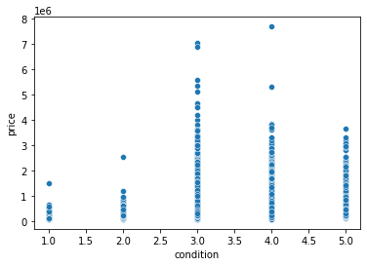
Condition
1 - Very Bad
2 - Bad
3 - Average
4 - Good
5 - Very Good
Average to very good condition house fetch more $$$

Slide 10
Conclusion

Slide 11
Ideal conditions for high market prices:
Average to very good conditions
Location matters
Spacious interiors
Summary

Slide 12
Recommendations

Slide 13
Recommendation 2
Further look into demographic and purchasing power of the people.
Recommendation 3
Renovating lower condition houses for sale/rent
Recommendation 3
Further look into distance to employment companies in the area to determine if it could be cause for settlement

Slide 14
The End

